Slide 1
MegaPipe: A New Programming Interface for Scalable Network I/O
Sangjin Han, et. al. UC Berkeley. OSDI’12

Slide 2
Research Target
Bulk-transfer workload
One-way
Large message
video streaming
Message-oriented workloads
High connection rate
Short message
HTTP, RPC, RAMcloud
BSD socket API
Cheap: saturate 10G link
CPU - intensive
Performance Limitation
Notes:
RPC : Remote Procedure Call Protocol 远程过程调用协议
RAMcloud: datacenter storage 数据中心存储

Slide 3
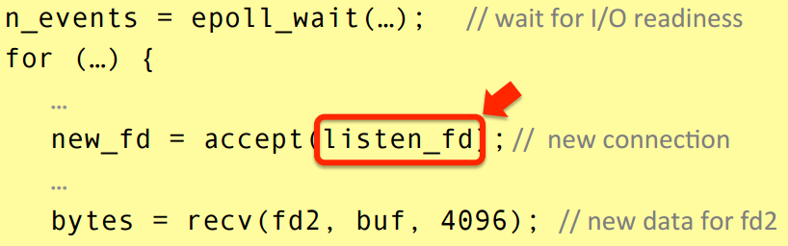
Challenge
BSD socket API
MegaPipe
Affinity-Accept
Shared listening socket
One core access at a time
File abstraction overhead
File descriptor
VFS overhead – 2 level ref
System call overhead
Lack of Connection Affinity
Shared listening socket
One core access at a time
Lack of Connection Affinity
Load balance - Scheduling
Not concern of socket call

Slide 4
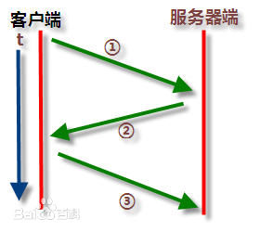
Experiment to see HOW bad
RPC-like test on an 8-core Linux server
Client: 768 clients
Server: 8 – core
Connection length: 10 transactions
Message size: 64B

Slide 5
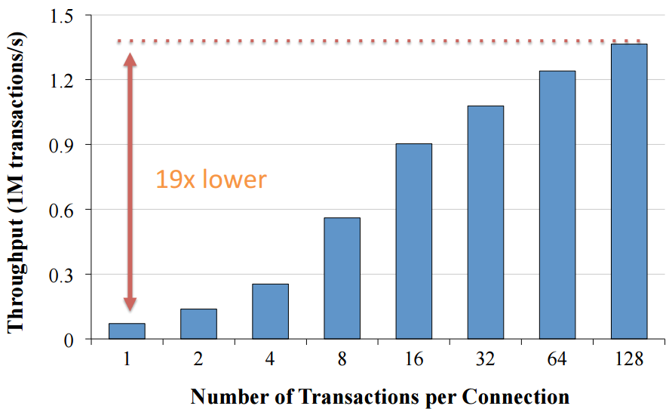
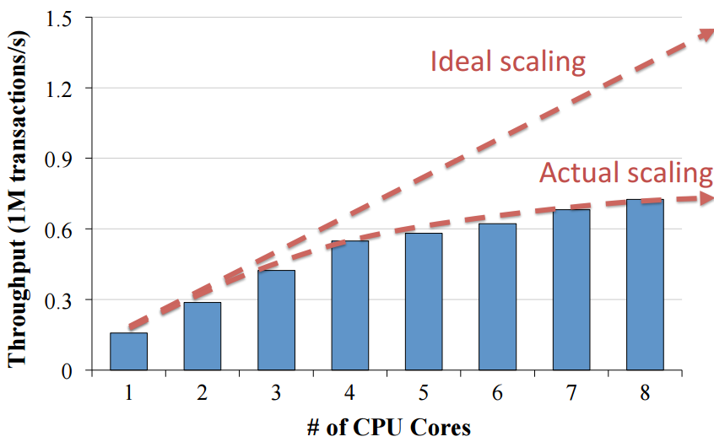
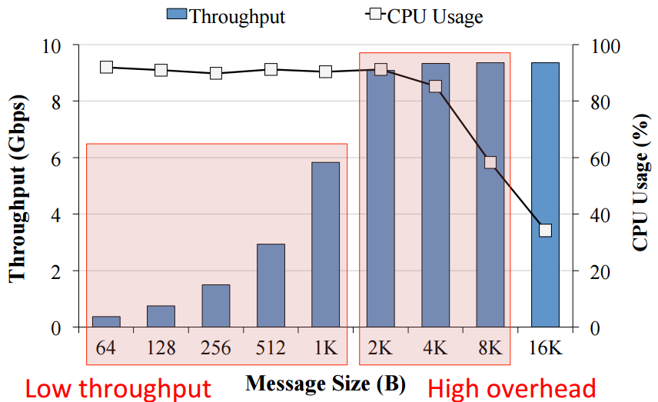
Experiment to see HOW bad

Slide 6
Solution – MegaPipe
Shared listening socket
File
File abstraction overhead
Sys Call
System call overhead
Socket
Listening socket partitioning
Light weight socket
Batching
File descriptor
VFS overhead
Bad scaling
Assign target
Affinity Accept

Slide 7
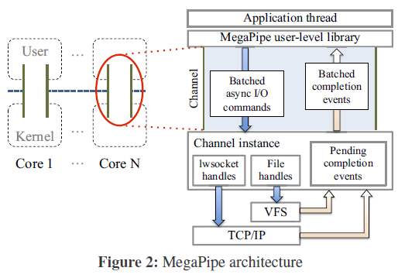
Solution – MegaPipe Structure
User
Poll: async requests
Non-blocking
Channel
Batching cmd & ack
Transparent
Kernel
New socket architecture
API
Affinity Accept

Slide 8
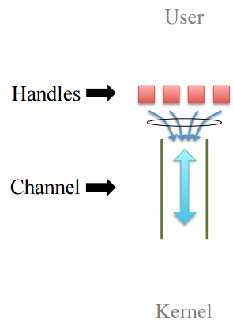
Details – User / Channel
User:
User issue request
Channel:
register a handle of socket/file
Request:
Batched
Data return
Batched

Slide 9
Details – User
Completion Notification Model
BSD socket API
Wait and Go
BSD socket API
Go and Wait
Issue request
Wait
Return data
Go on processing
Issue request
Go on processing
Interrupt
Return Data

Slide 10
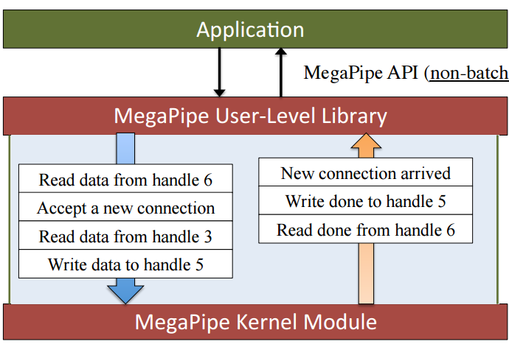
Details – Channel
Transparent batching
Mutiplex
TDM
Buffer transparent
Flush via TDM
Ping-pang

Slide 11
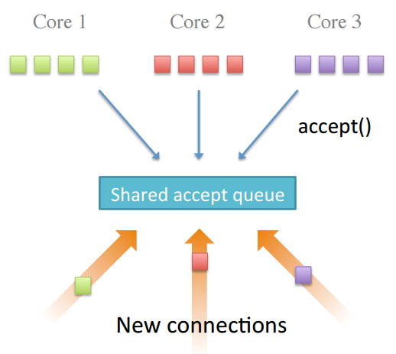
Details – kernel

Slide 12
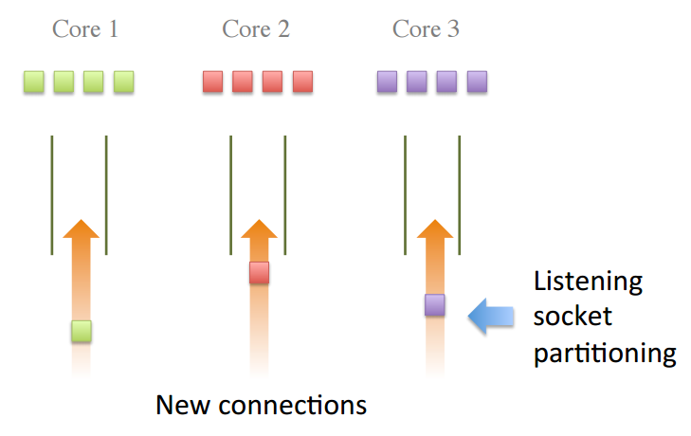
Details – kernel
The same with Affinity Accept
Per-core accept queue

Slide 13
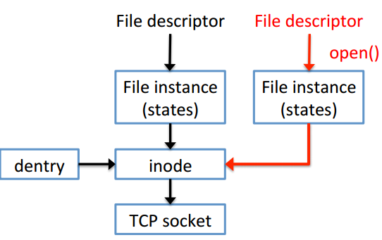
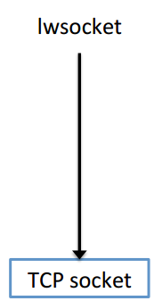
Details – Socket
Use lwsocket : light weight socket —— main contribution
FD table
VFS
TCP/IP

Slide 14
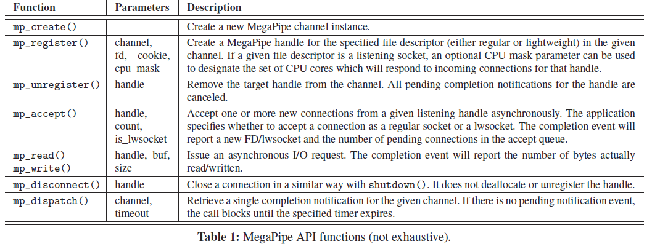
MegaPipe API

Slide 15
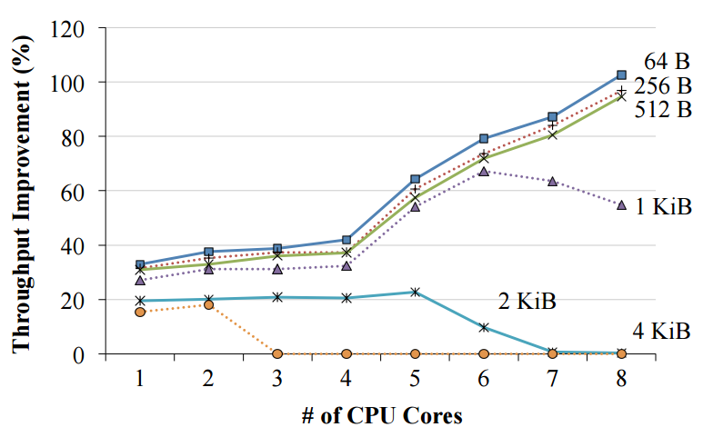
Evaluation – throughput / message size
Message size
Low improve for Large Size
Fewer cores: batching
More core for large size: saturate
1KB is weird

Slide 16
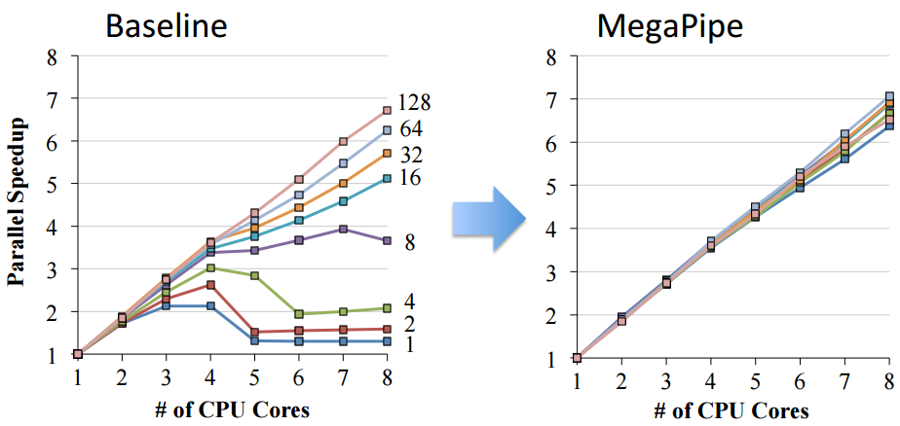
Evaluation – throughput / message size

Slide 17
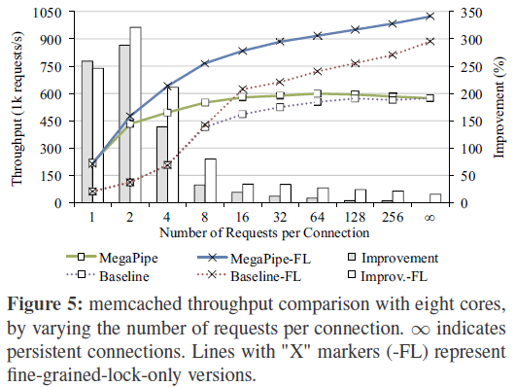
Evaluation – Memcached
Notes:
Long persistent connection

Slide 18
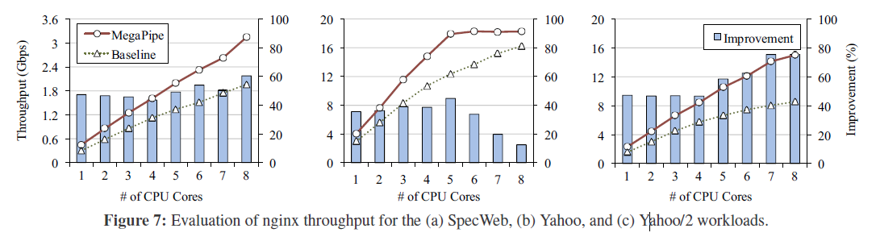
Evaluation – Real Case

Slide 19
Summary – compare with Affinity Accept
Motivation
More clear in MP
Characteristic of message-orient workload
File abstract overhead/syscall overhead
Larger Opt Space/Range
Entire Architecture :
MP: User API(async/non-block), Channel(batched-innovation), socket partition, lwsocket
MP is explicit to control the partition
AA: socket partition, load balance, sys call modify(very simple) —— AA is more detail
Experiment
More redundant in MP —— not so sure.

